Slide 1
Bayesian classifiers

Slide 2
Bayesian Classification: Why?
Probabilistic learning: Calculate explicit probabilities for hypothesis, among the most practical approaches to certain types of learning problems
Incremental: Each training example can incrementally increase/decrease the probability that a hypothesis is correct. Prior knowledge can be combined with observed data.
Probabilistic prediction: Predict multiple hypotheses, weighted by their probabilities
Standard: Even when Bayesian methods are computationally intractable, they can provide a standard of optimal decision making against which other methods can be measured

Slide 3
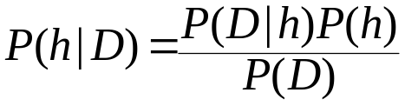
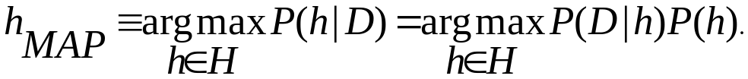
Bayesian Theorem
Given training data D, posteriori probability of a hypothesis h, P(h|D) follows the Bayes theorem
MAP (maximum posteriori) hypothesis
Practical difficulty: require initial knowledge of many probabilities, significant computational cost

Slide 4
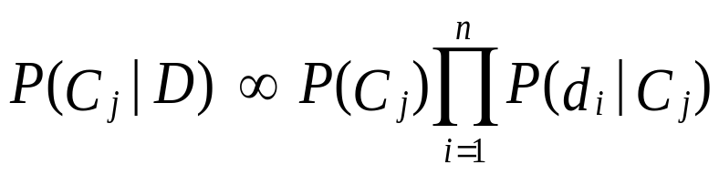
Naïve Bayes Classifier (I)
A simplified assumption: attributes are conditionally independent:
Greatly reduces the computation cost, only count the class distribution.

Slide 5
Naïve Bayesian Classification
If i-th attribute is categorical:
P(d_{i}|C) is estimated as the relative freq of samples having value d_{i} as i-th attribute in class C
If i-th attribute is continuous:
P(d_{i}|C) is estimated thru a Gaussian density function
Computationally easy in both cases

Slide 6
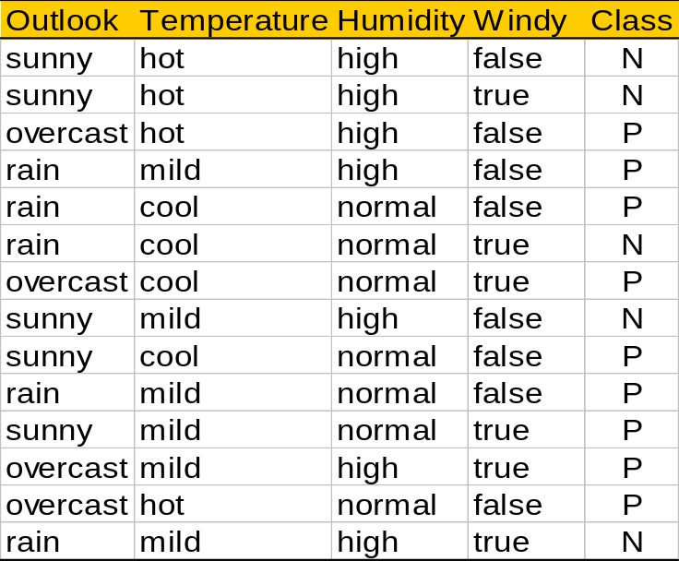
Play-tennis example: estimating P(x_{i}|C)
outlook
P(sunny|p) = 2/9
P(sunny|n) = 3/5
P(overcast|p) = 4/9
P(overcast|n) = 0
P(rain|p) = 3/9
P(rain|n) = 2/5
temperature
P(hot|p) = 2/9
P(hot|n) = 2/5
P(mild|p) = 4/9
P(mild|n) = 2/5
P(cool|p) = 3/9
P(cool|n) = 1/5
humidity
P(high|p) = 3/9
P(high|n) = 4/5
P(p) = 9/14
P(normal|p) = 6/9
P(normal|n) = 2/5
P(n) = 5/14
windy
P(true|p) = 3/9
P(true|n) = 3/5
P(false|p) = 6/9
P(false|n) = 2/5

Slide 7
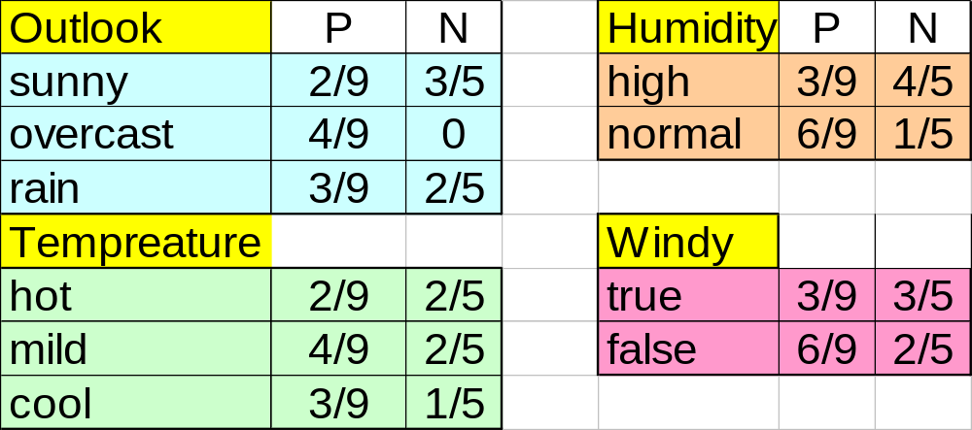
Naive Bayesian Classifier (II)
Given a training set, we can compute the probabilities

Slide 8
Play-tennis example: classifying X
An unseen sample X = <rain, hot, high, false>
P(X|p)·P(p) =
P(rain|p)·P(hot|p)·P(high|p)·P(false|p)·P(p) = 3/9·2/9·3/9·6/9·9/14 = 0.010582
P(X|n)·P(n) =
P(rain|n)·P(hot|n)·P(high|n)·P(false|n)·P(n) = 2/5·2/5·4/5·2/5·5/14 = 0.018286
Sample X is classified in class n (don’t play)

Slide 9
The independence hypothesis…
… makes computation possible
… yields optimal classifiers when satisfied
… but is seldom satisfied in practice, as attributes (variables) are often correlated.
Attempts to overcome this limitation:
  Bayesian networks, that combine Bayesian reasoning with causal relationships between attributes

